Slide 1
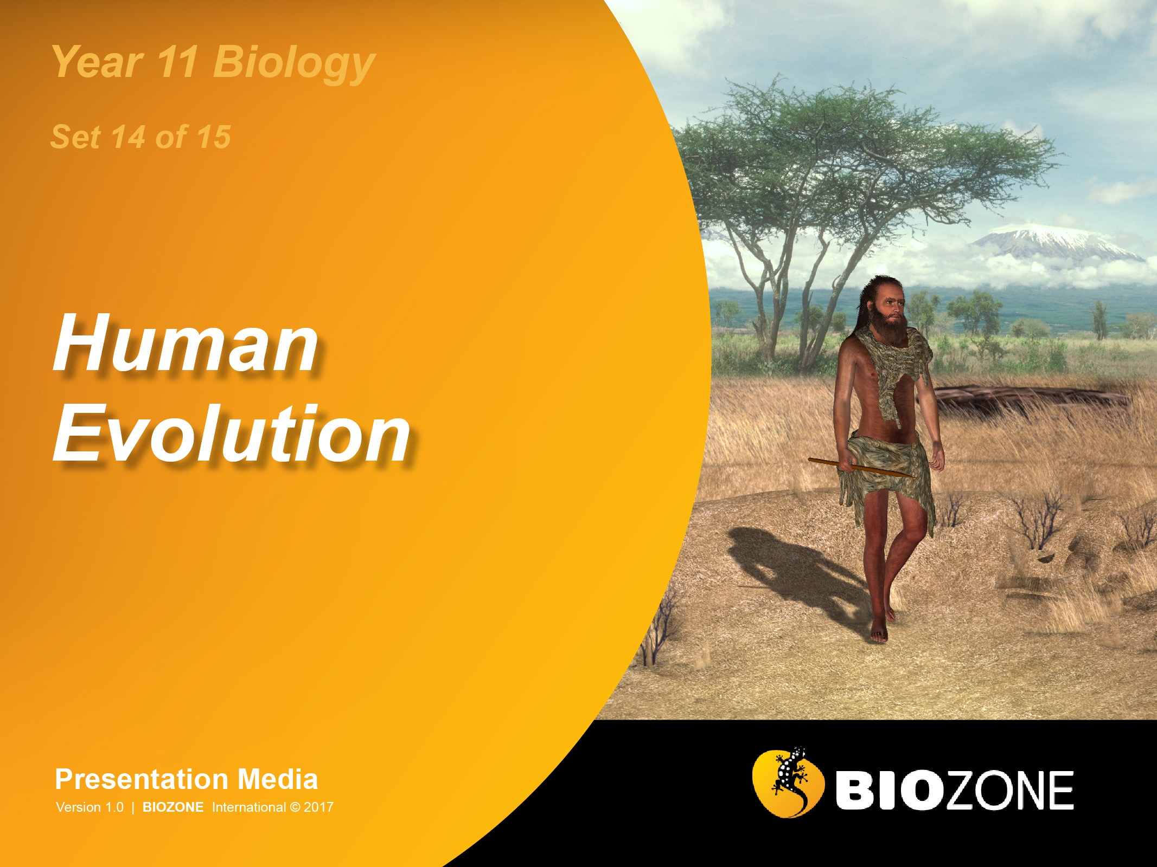

Slide 2

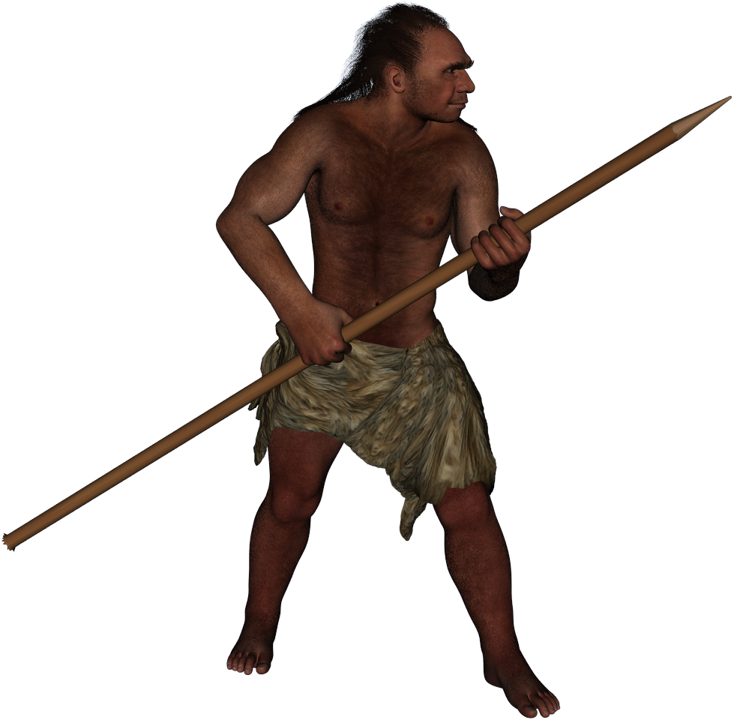
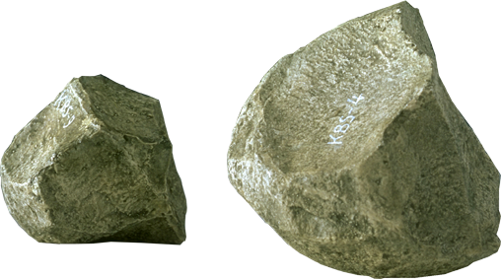
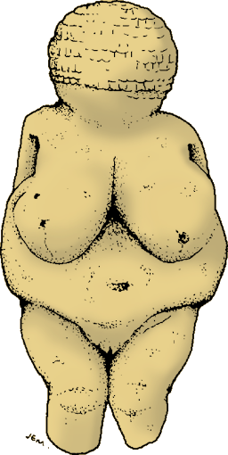
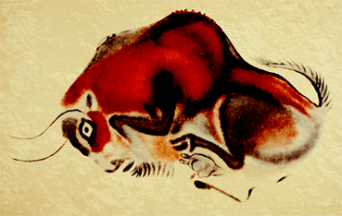
Cultural Evolution
The biological evolution of humans was accompanied by a cultural evolution, marked by three phases in prehistoric times:
Palaeolithic (Old Stone Age)
Mesolithic (Middle Stone Age)
Neolithic (New Stone Age)

Slide 3
Evolution of Behaviour
Coupled with the brain’s evolutionary development is the increasingly complex behaviour exhibited by hominins:
Natural history
intelligence
Predict the future by understanding:
• the habits of game
• the rhythms of the seasons
• the geography of the landscape
Social intelligence
Group bonding behaviour improves survival opportunities for members. Language allowed early humans to:
• communicate ideas
• plan survival strategies
• coordinate hunting and gathering
Technical intelligence
Producing and using artefacts required an understanding of abstract ideas and physical processes:
• the fracturing behaviour of stone
• best angles of striking stone
• how hard to strike a stone
• trajectory of a thrown projectile
The modern human mind
Creating artefacts and images with symbolic meanings as a means of communication
Using knowledge of animal habits, tools, advanced planning and communication to coordinate the hunting of large game

Slide 4
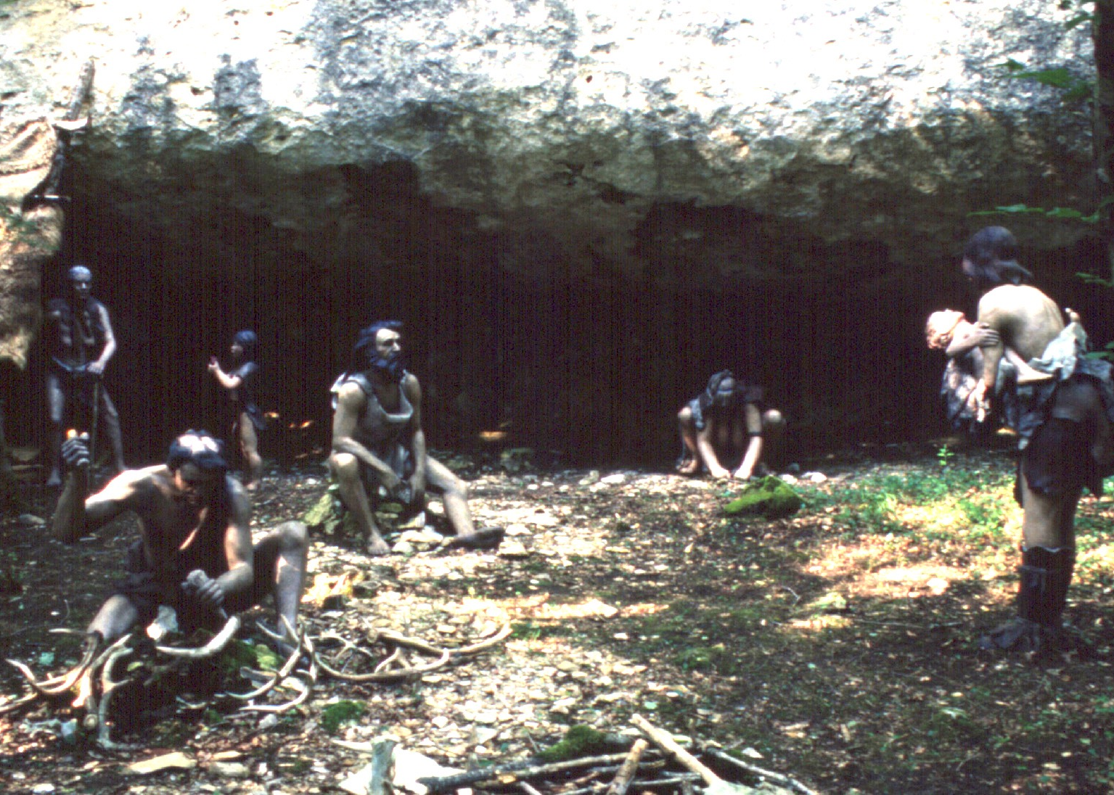
Complex Behaviours
Enhancing the natural protection of rock shelter
Prolonged infant dependency
Caring for the elderly
Making clothes from animal skins
Toolmaking using flint
Toolmaking using bone and antler

Slide 5
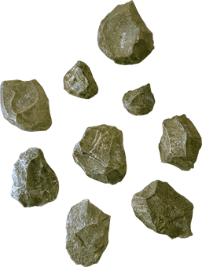
Oldowan Tool Culture
First appeared: 2.5 mya
Associated hominin: Homo habilis
These tools were simple river-worn pebbles that were crudely fashioned with only a few flakes being removed.
These tools typically had flakes knocked from several angles to produce a core with a cutting edge (e.g. chopper, discoid, polyhedron).
Although the cores may have been used as tools, it is known that the sharp flakes were also useful in cutting.

Slide 6
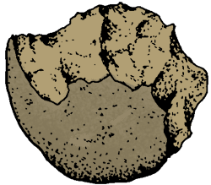
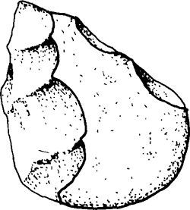
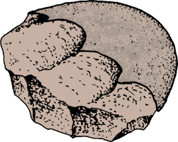
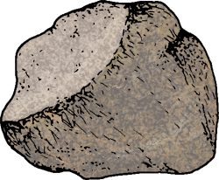
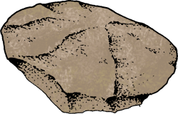
Oldowan Tool Culture
Flakes removed from 1 side only
Flakes removed from 2 sides
Core
Choppers
Proto-biface
Flakes removed from all sides
Core
Polyhedron
Discoid

Slide 7
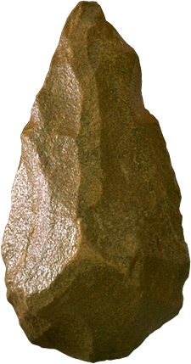
Acheulian Tool Culture
First Appeared: 1.76 mya
Associated hominin: Homo erectus
These tools were typically 'tear drop' in shape and were carefully crafted with a slight bulge on each broad surface (called a 'bi-face').
They ranged greatly in their size and are often called 'hand axes' although it is not clearly understood how they were used.
They differ markedly from the earlier pebble tools in that there appears to be a standard “design” and each tool is manufactured using a great many more blows to remove flakes.

Slide 8
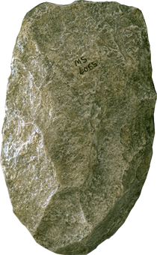
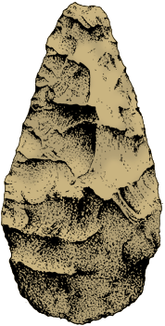
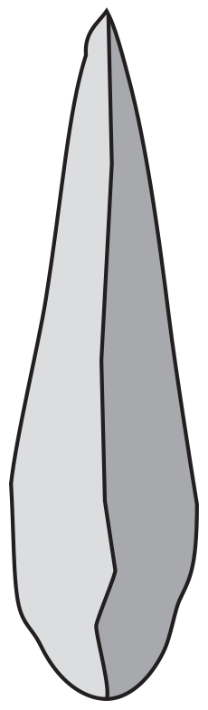
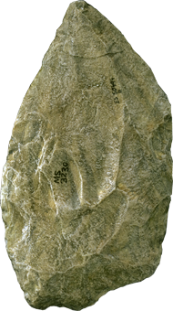
Acheulian Tool Culture
Hand axe
Typical 'tear-drop' shape of an Acheulian biface tool
The core is the tool
Flatter and more ‘blade-like’
The core is the tool
‘Biface’ shape – bulges outwards on both sides and has ‘tear drop’ shape
Cleavers
Side-on view

Slide 9
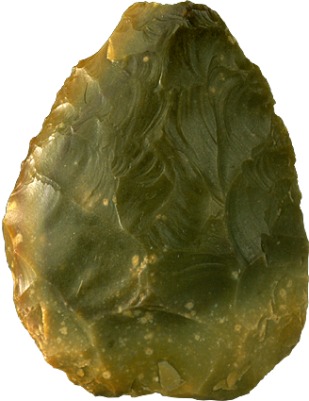
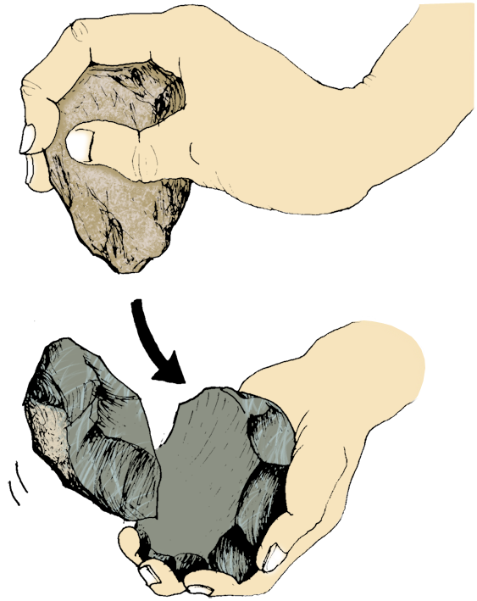
Mousterian Tool Culture
First appeared: 150,000 years ago
Associated hominin: Homo neanderthalensis
More refined tool culture than the earlier Acheulian tool culture.
Flint became a preferred material to produce stone tools because of the very predictable way in which it would chip when struck with another hard object (much finer workmanship was possible).
The Levallois tool making method involved preparing a core and striking off a large oval flake which was then retouched on one surface only.
Making a scraper by the Levallois method

Slide 10
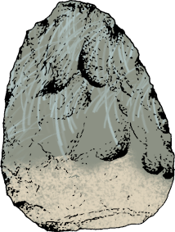
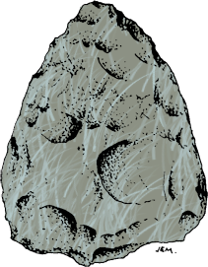
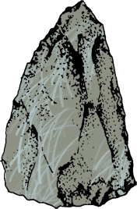
Mousterian Tool Culture
Side scraper
from Le Moustier, France
Flint, length 9cm
The scraper made by the Levallois flake method is retouched on one surface.
Handaxe
from Le Moustier, France
Flint, length 8.5 cm
Levallois point
from Le Moustier, France
Flint, length 6 cm

Slide 11
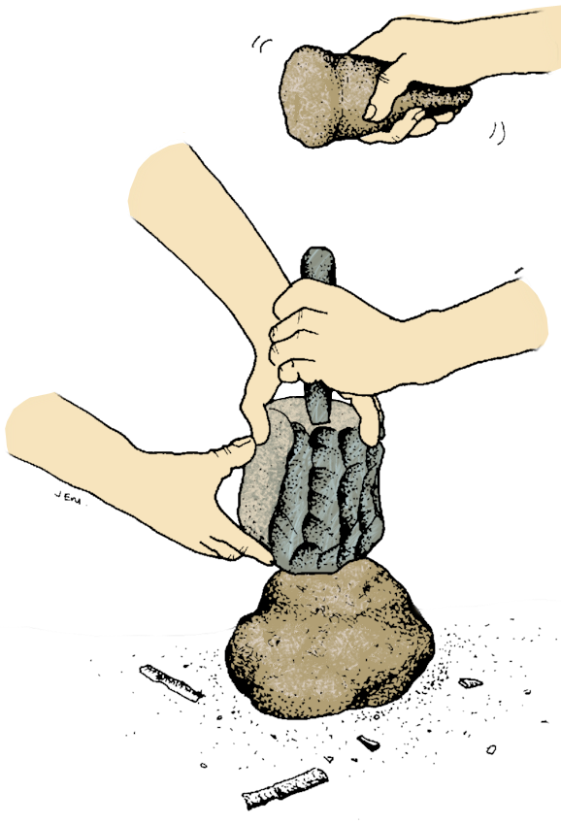
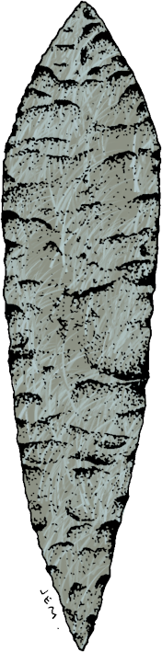
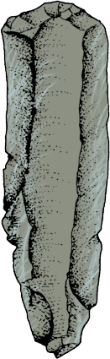
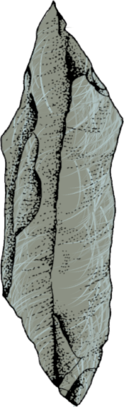

Upper Palaeolithic Tool Culture
Punch blade method
Hammer stone
Antler or bone punch
Solutrean blade
Finely worked edge
Side scraper
Core
Anvil stone
Burin
used as a drill
Blades and waste flakes

Slide 12
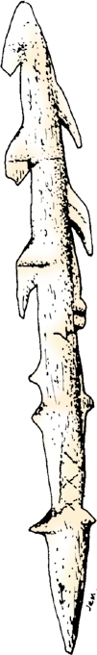
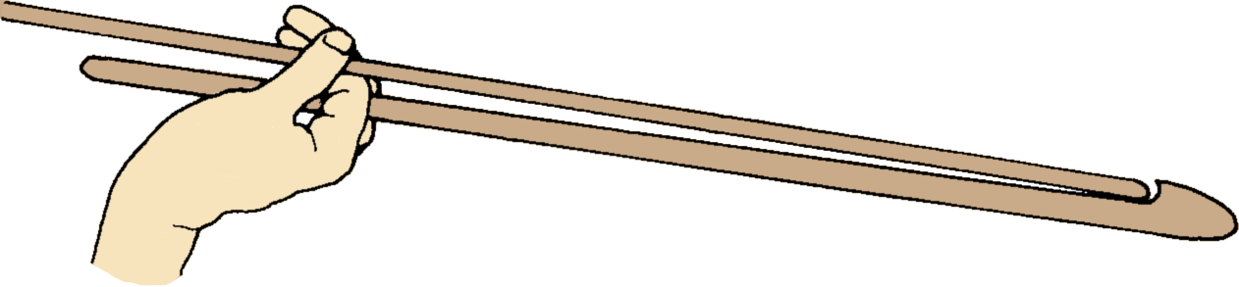
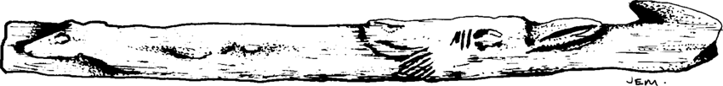
Upper Palaeolithic Tool Culture
Throwing sticks were a major development in the arsenal of the Palaeolithic hunter.
They drastically increased the ballistic range of the spear and tipped the balance in favour of the hunter.
Bone needle
Throwing stick
Harpoon heads made from bone or antler

Slide 13
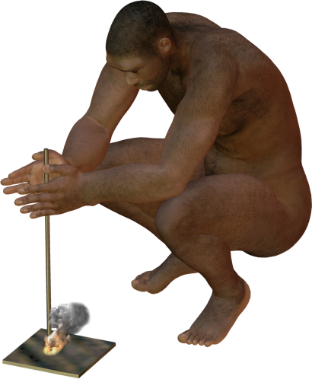
Use of Fire
The earliest record of humans using fire:
Africa: 1.5 mya (although this date is disputed)
France: 750,000 years ago
China: 500,000 years ago
At first, fire may have been ‘captured’ from natural sources, such as bush fires caused by lightning.
Later, humans developed techniques to create fire on demand.

Slide 14
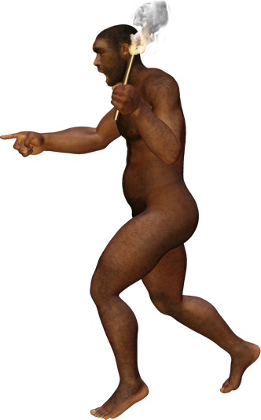
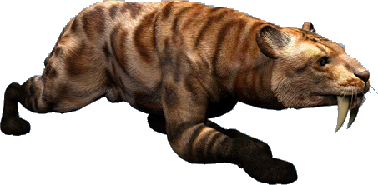
Use of Fire
With fire early humans could:
Remain active at night: People began using fire as a source of light to continue their activities after dark and inside their caves.
Cook with fire: Made the meat of the animals they killed more palatable and digestible. They learned to preserve meat by smoking it over a fire, vastly decreasing the danger of periodic starvation. Cooking also enabled them to add some formerly inedible plants to their diet.
Make better weapons and tools: Hunters formed spears from tree branches by burning the tips of the branches and then scraping the charred ends into a point.
Protect themselves from predators
Warm themselves

Slide 15
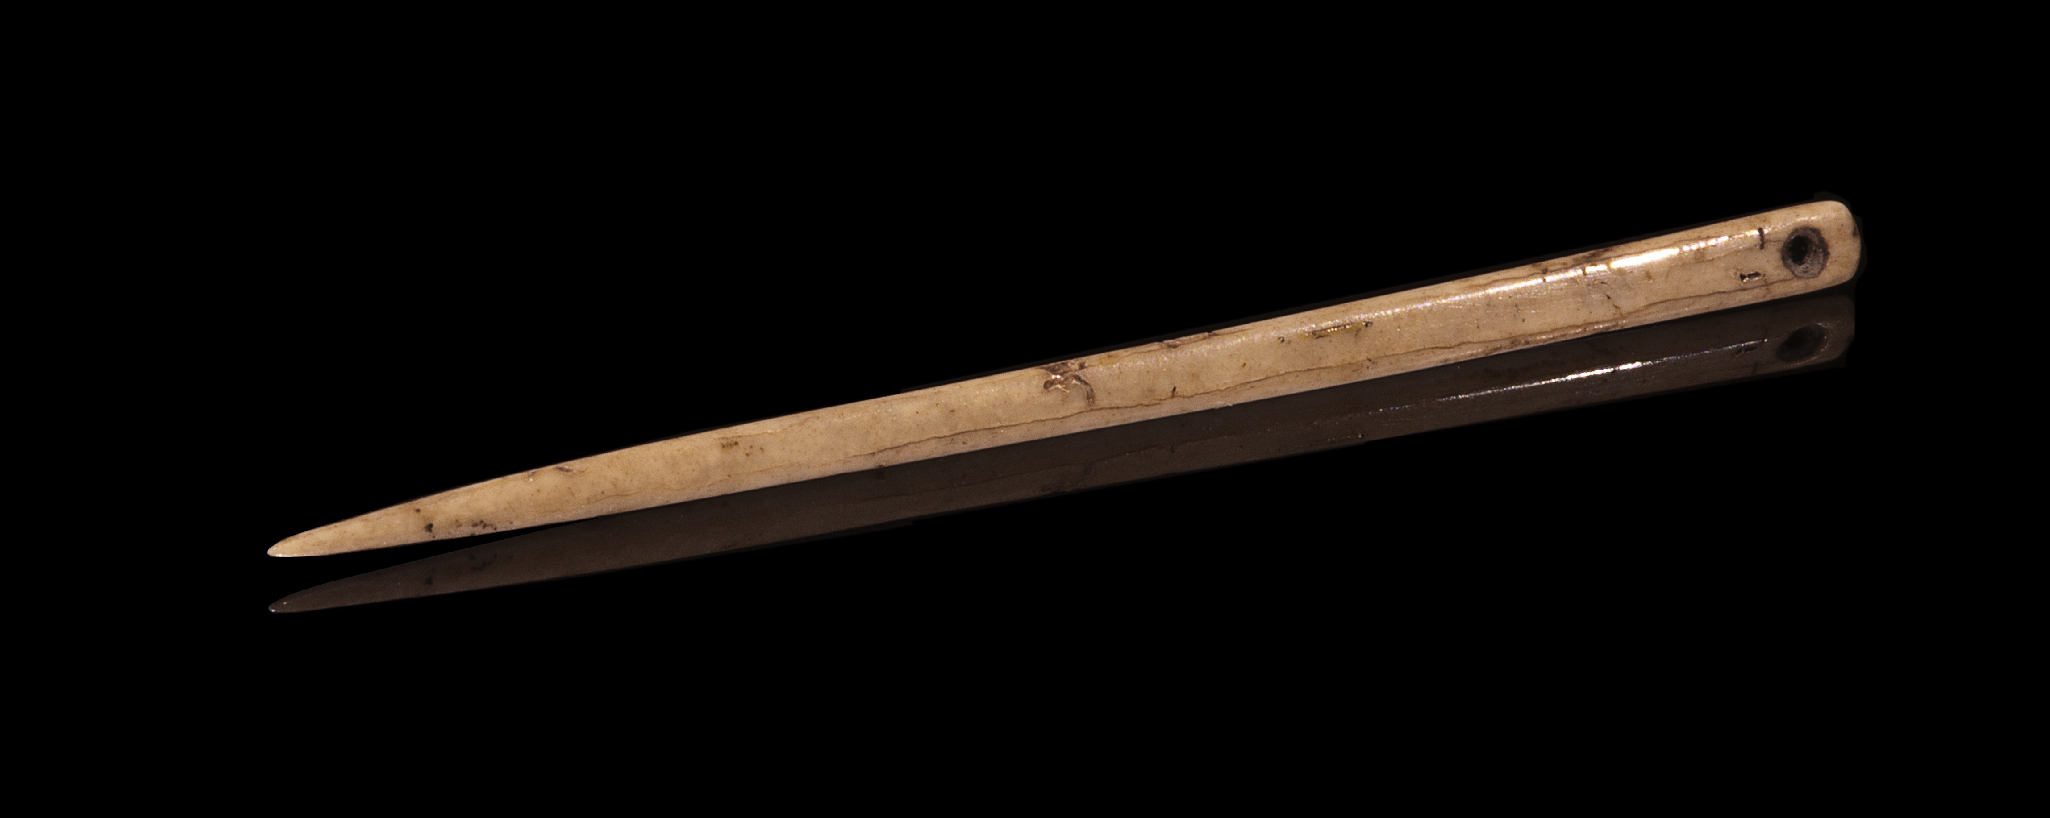
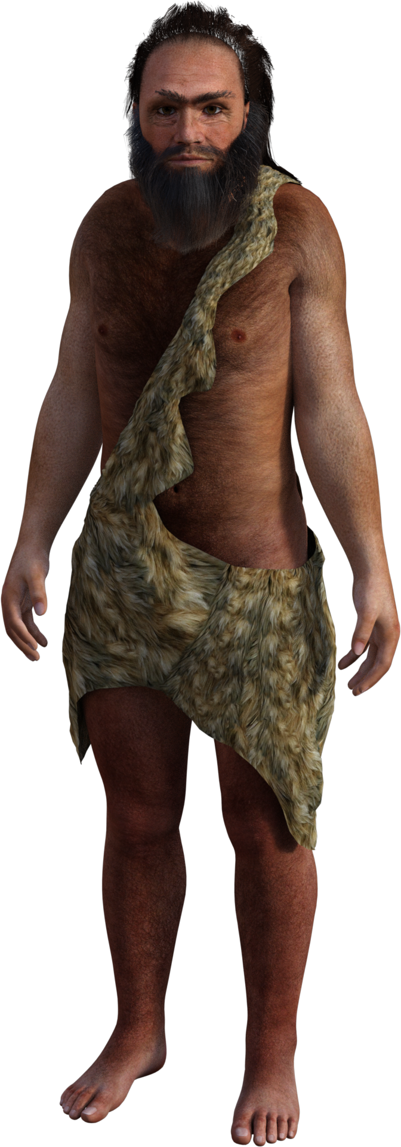
Clothing
There is little direct evidence of humans wearing clothes until 26,000 years ago (the evidence is a finely worked bone needle).
Evidence from burial sites also shows humans were adorning themselves (or at least their dead) with necklaces as far back as 35,000 years ago.
Evidence from the evolution of body lice suggests human ancestors began wearing clothes some 100,000 years ago.
Didier Descouens CC 3.0
This finely worked bone needle is almost identical in shape to needles used today. This needle is dated between 17,000 and 10,000 years old.

Slide 16
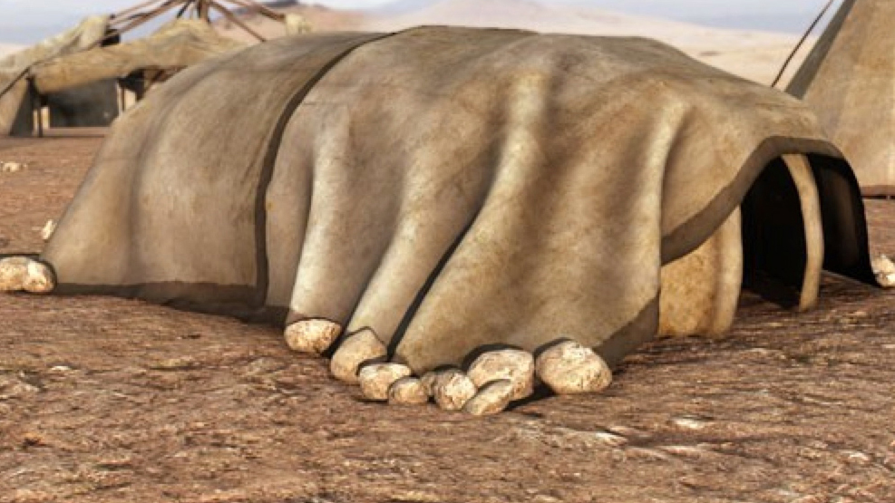
Shelter
The first evidence of humans building purpose-built shelters dates to around 400,000 years ago.
Post holes in the ground indicate poles were used as scaffolding for the shelter.
Preserved bones from around 17,000 years ago in the Ukraine show humans there used mammoth bones and tusks as scaffolding, probably because there would have been few trees available to make wood scaffolding from.

Slide 17
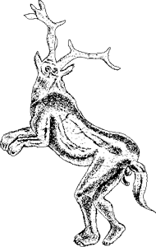
Palaeolithic Art
Sculpture (10 cm high) carved out of limestone about 30,000 years ago (note exaggerated breasts and body fat)
Modern humans underwent a cultural explosion about 35,000 years ago giving rise to prehistoric art and new kinds of tools.
The stimulus was probably a need to represent in some lasting way, ideas concerned with the unknown:
Death
Hunting success
Fertility of their women
Painting of a sorcerer dressed in animal skins (15,000 years old) on a cave wall in the Pyrenees Mountains
Early examples of rock art are found in southern France, northern Spain, and Australia

Slide 18
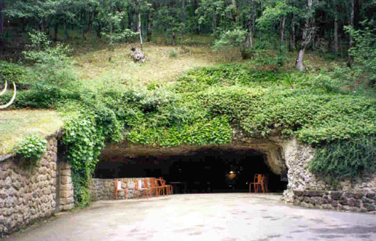
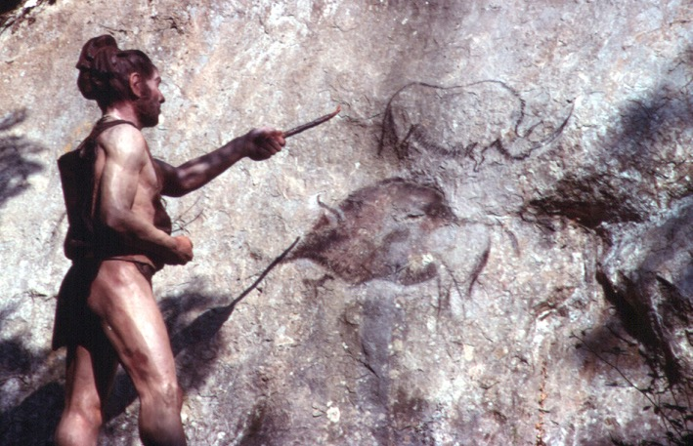
Spiritual Thinking
There are several hundred caves in southern France and Spain that were used by early humans.
Some of these caves contain rock paintings made by Cro-Magnon shaman.
A possible explanation for cave paintings, which is based on hunter-gatherer societies, is that shaman paint images of their visions while in the cave darkness.

Slide 19
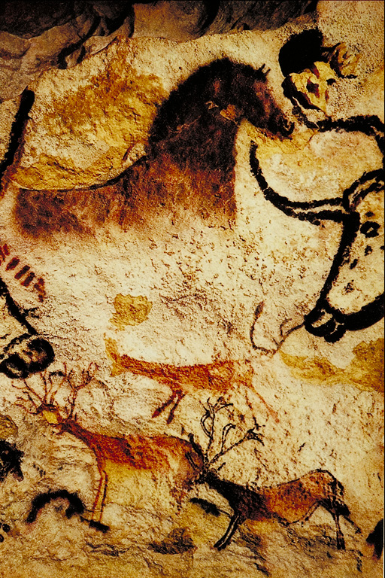
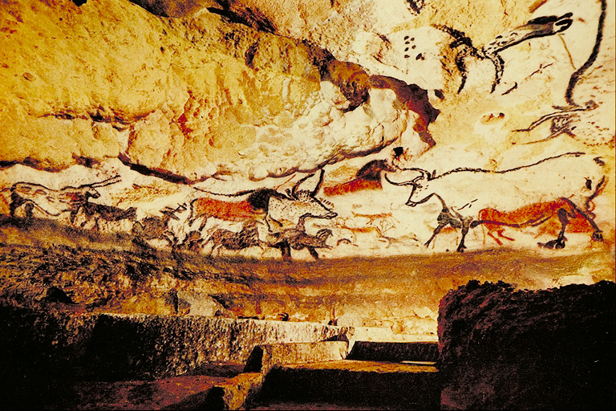
Cave Art
One of the most famous examples of Palaeolithic art is found in the caves at Lascaux in the Dordogne Valley, France. Deer, bison, aurochs, and horses were common subjects.

Slide 20
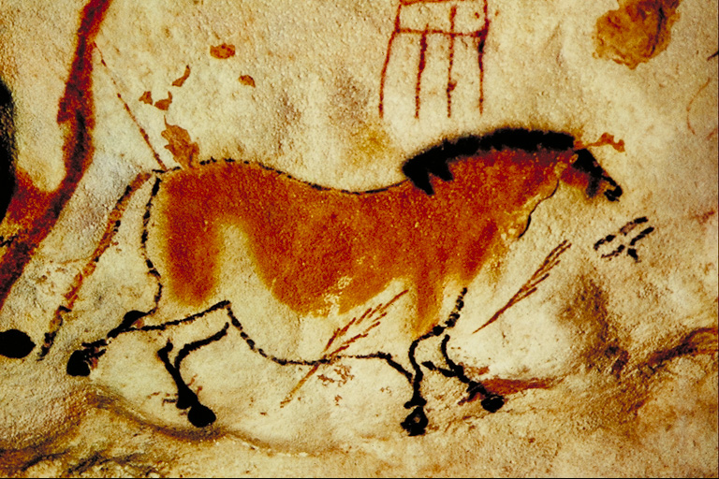
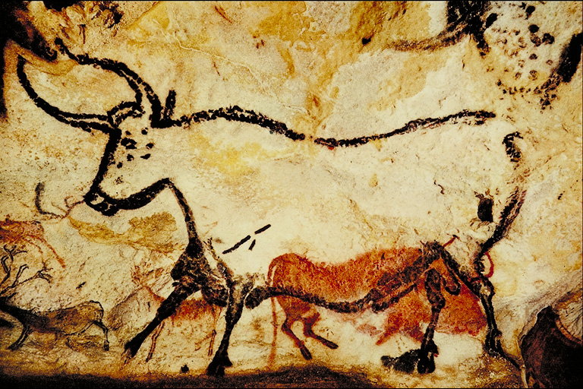
Palaeolithic Art
Lascaux caves contain some of the earliest known art, dating back to somewhere between 13,000 and 15,000 BC, or as far back as 25,000 BC.
Top: A horse depicted with possible spears being thrown at it. Note the geometric symbol above the horse (its meaning is unknown).
Right: An aurochs (a now extinct, giant ox) is painted over earlier images of reindeer.

Slide 21
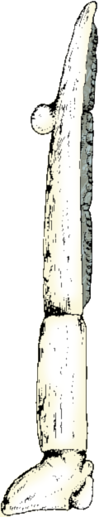

Mesolithic Cultures
Mesolithic period: Middle Stone Age
First appeared: 12-10,000 years ago
Foraging and fishing economy
Characterised by:
the use of small stone tools (called microliths)
a broad-based hunting and gathering economy (including foraging for seeds from wild cereal grasses).
Sickles
Used to cut the grasses to gather their seeds
Microliths
Bone fish hook

Slide 22
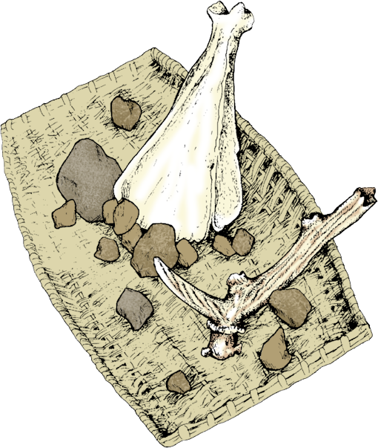

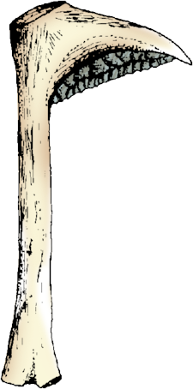
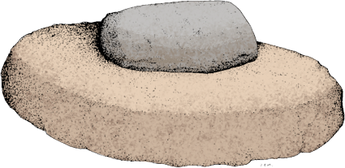
Neolithic Cultures
Neolithic excavation kit
Ox shoulder blade shovel
Antler pick
Neolithic period: New Stone Age
First appeared: 10,000 years ago in the Middle East
Plant cultivation and animal domestication
The Neolithic culture is usually associated with the beginnings of agriculture, pottery and permanent settlements in the Old World.
This shift away from a hunter-gatherer economy, to one which could provide surplus food, meant greater population densities could be achieved and some people were free to develop as artisans.
Wickerwork basket
Arrow head
Rubbing stone
Microliths
Quern stone
Quern
used to grind cereal seeds
Sickles
Used to cut the grasses to gather their seeds

Slide 23
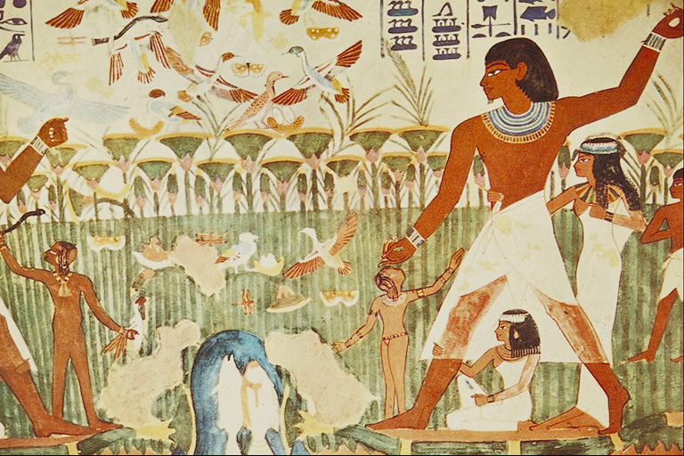
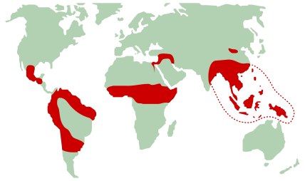
The Beginning of Agriculture
Farming began in different parts of the world at different times:
Earliest evidence is found in the so-called ‘fertile crescent’ running from Egypt to the Persian Gulf about 10,000 years ago.
By about 7,000 years ago, agriculture became established in China.
This was followed by Mesoamerica (Guatemala, Honduras and southern Mexico) about 5,000 years ago.

Slide 24
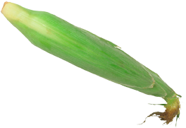
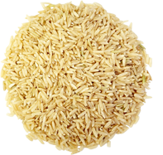




The Beginning of Agriculture
Fertile Crescent
Barley, wheat, emmer, einkorn, lentils, peas, sheep, goats, cattle
10,000 years ago
North China
Rice and millet
7,000 years ago
Mesoamerica
Beans, maize, peppers,
squash, gourds, cotton,
guinea-pigs, llamas
8,000 years ago
South America
Lima beans, potatoes, squash, beans, and pumpkins
8,000 years ago
Africa
Millets, sorghum, groundnuts, yams, dates, coffee, and melons
> 4,000 years ago
Southeast Asia
Rice, bananas, sugar cane, tea, citrus fruits, coconuts, yam, millet, soya beans, taro, pigs
> 4,000 years ago

Slide 25











Domestication of Animals
Numerous animals have been domesticated by humans over the last 10,000 years in many parts of the world:
Domesticated Animal | Wild Ancestor | Region of Origin | Date (Years ago)
Dog | Wolf | many places? | 13,000
Goat | Bezoar goat | Iraq | 10,000
Sheep | Asiatic mouflon | Iran, Iraq, Levant | 11,000
Cattle | Aurochs | Southwest Asia | 8,500
Pig | Boar | Anatolia | 9,000
Domestic fowl | Red jungle fowl | Indus Valley | 4,000
Horse | Wild horse | Southern Ukraine | 6,000
Arabian camel | Wild camel | Southern Arabia | 5,000
Bactrian camel | Wild camel | Iran | 4,500
Llama | Guanaco | Andean plateau | 6,000
Water buffalo | Indian wild buffalo | Indus Valley | 4,500
Ass | Wild ass | Northeast Africa | 5,500
Arabian camel
Bactrian camel
Sheep
Horse
Cattle
Goat
Water buffalo
Dog
Pig
Ass
Llama

Slide 26


Slide 27
Conditions of Use
NOTE: Presentation Media = presentations available on CD-ROM/DVD-ROM or as downloads
BIOZONE retains copyright to the intellectual property included in the Presentation Media files, with acknowledgement that certain photos are used under license and are credited appropriately.
You MAY:
Use the Presentation Media files for presentations in your classrooms using a data projector, interactive whiteboard or overhead projector.
Place the Presentation Media files on any staff computer within the school, including staff laptops, but not in contradiction to clause (g).
Place the Presentation Media files on:
The school’s intranet (school computer network)
VLE (Virtual Learning Environment)
A CMS (Content Management System).
Student and staff access must be restricted to those who are enrolled/working on the campus of the registered purchaser. Student and staff access to a VLE or a CMS must be controlled by a user login and password protocol, but not in contradiction to clause (f). If students have access, they need to be made aware of the Conditions of Use and are only allowed to view the content.
Edit and customise the Presentation Media files by adding, deleting, and modifying information to better suit your needs, but not in contradiction to clauses 2 (c) - (d).
Print out the Presentation Media files in PowerPoint® or Keynote® “Handouts” mode for the express purpose of allowing students to make their own notes about the presentation, but not in contradiction to clause (e).
You MAY NOT:
Place the Presentation Media files on to the Internet or on a service that may be accessed off-campus unless access to the service is protected by a user login and password protocol, and is restricted to students and staff enrolled/working on the campus of the registered purchaser.
Place the Presentation Media files on student laptop computers.
REMOVE any of the references to BIOZONE, the title slides, copyright notices, photo credits, or Conditions of Use from the Presentation Media files.
Create a NEW document using any of the graphics/images in the Presentation Media files.
Print the Presentation Media files on to paper to make your own worksheets for distribution to students.
Incorporate any part of the Presentation Media files for the production of another commercial product.
Share or give away any content off-campus. This prohibition apples to, but is not limited to, sharing via the Internet or any website, (examples: YouTube, slide sharing websites).
Conditions of Use are subject to change without notice. Visit http://www.biozone.com.au/faqconditionsofuse/

Slide 28
Photo Credits
Photographic images are used under license from the following commercial photo libraries:
Corel Corporation Professional Photos (uncoded)
ArtToday.com (coded AT)
Clipart.com (coded CA)
PhotoObjects.com (coded PO)
iStock.com (coded iStock)
Hemera Technologies Inc. (coded Hemera)
Photos.com (coded PC)
Education interactive (coded EII)
Digital Stock (coded DS)
LifeArt (coded LA)
Dollar Photo Club (coded DPC)
3D models were created using Poser
Additional artwork and photographs are the property of BIOZONE International Ltd. All rights reserved.
Some 2D artwork has been adapted from TechPool STUDIOS LifeArt Collections, used under licence.
Images from the Public Domain: Where these licenses have been used, authors and licenses have been acknowledged alongside their image.
Centers for Disease Control (coded CDC)
National Institutes of Health (coded NIH)
National Aeronautics and Space Administration (NASA)
U.S. Department of Agriculture (coded USDA)
Images from the public domain include limited copyright, copyright expired, uncopyrighted, or uncopyrightable material:
Licenses including: GNU Free Documentation License http://www.gnu.org/copyleft/fdl.html
Creative Commons Attribution Share Alike http://creativecommons.org/licenses/by-sa/3.0/
Wikimedia Commons
NOTE: Where images are edited or moved from or within this file, the accompanying photo credit must be retained.

Slide 29


